Slide 1
Introduction to Design
Week 1

Slide 2
Creative tools
Web Browser
Chrome
Safari
Firefox
Opera
Edge
Code Editor
Atom
Sublime
Visual Studio Code
WebStorm
Brackets
Prototyping
Figma
Adobe XD
Keynote
Powerpoint
Illustrator

Slide 3
What is design?
Notes:
We’ve typically started the first design lecture with a lot of visual hierarchy and color and in my opinion I didn’t think it gave the most comprehensive or interesting view as to what it entails.

Slide 4
Design is not purely aesthetics.
Notes:
A lot of folks think design is about making things “look pretty.” There’s much more to intentional, thoughtful decisions that create the everyday interactions we have with objects, applications, and obviously websites.

Slide 5
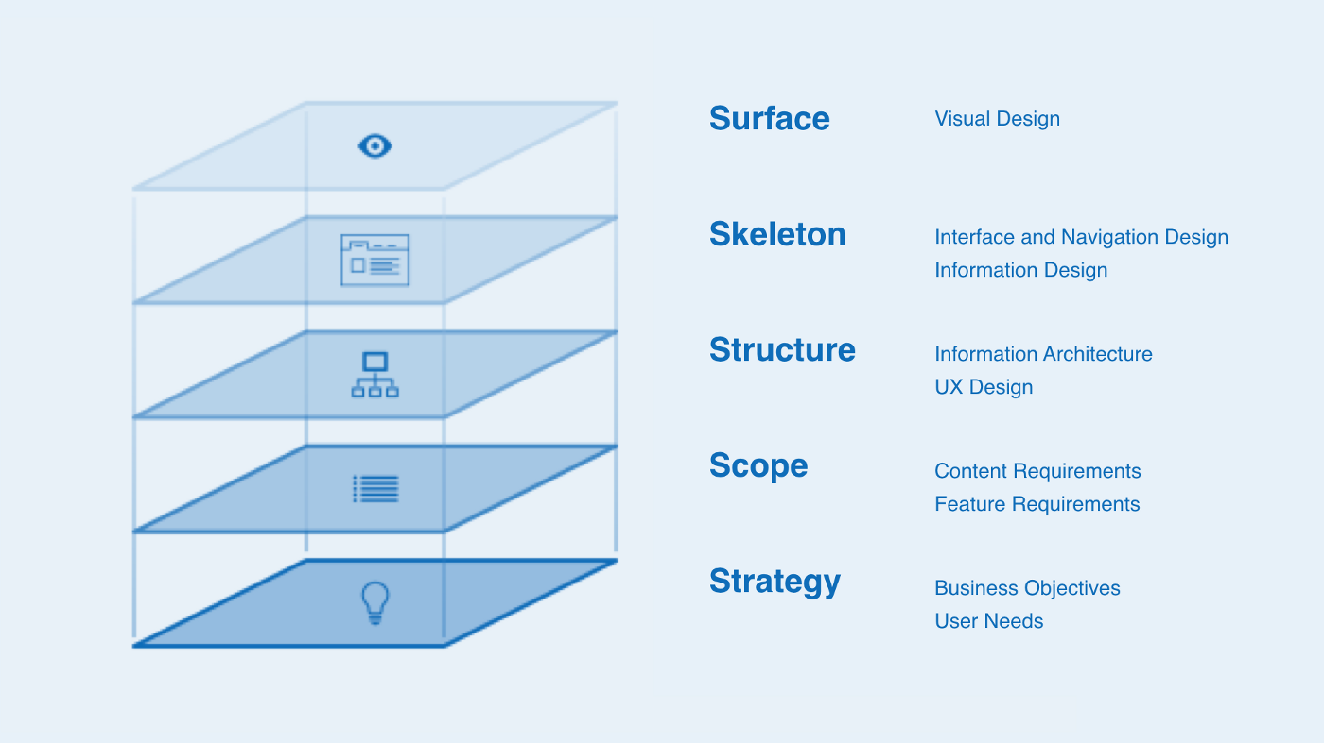
Notes:
There is much more to design than the visual aesthetics. The visual aspect of design is actually really just the surface of design. This is a really great diagram of the layers of components that make up the design.

Slide 6
It’s not about making things pretty.
Notes:
I know a lot of you might want to say to me, “But JemmMmMmammamammamAAAA! ! ! ! I just want to make pretty things. That’s why I took this class!” And I’ll respond to you, “Pretty shit is still shit” :^) behind every design, you should be thoughtfully considering the decisions and impacts of design. I highly recommend referencing the previous slide to really understand how the layers of design really stack on each other. The prettiest of designs can still be ridiculously difficult to use.

Slide 7
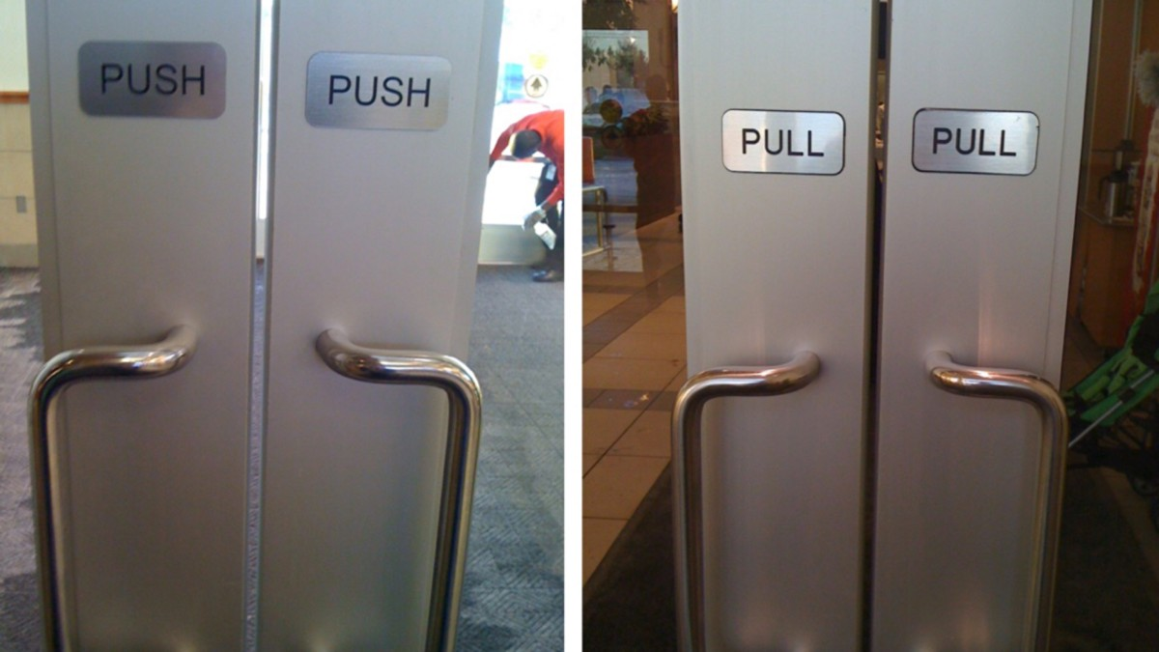

Slide 8
Norman Doors, Vox

Slide 9
At its very worst, design can kill.

Slide 10
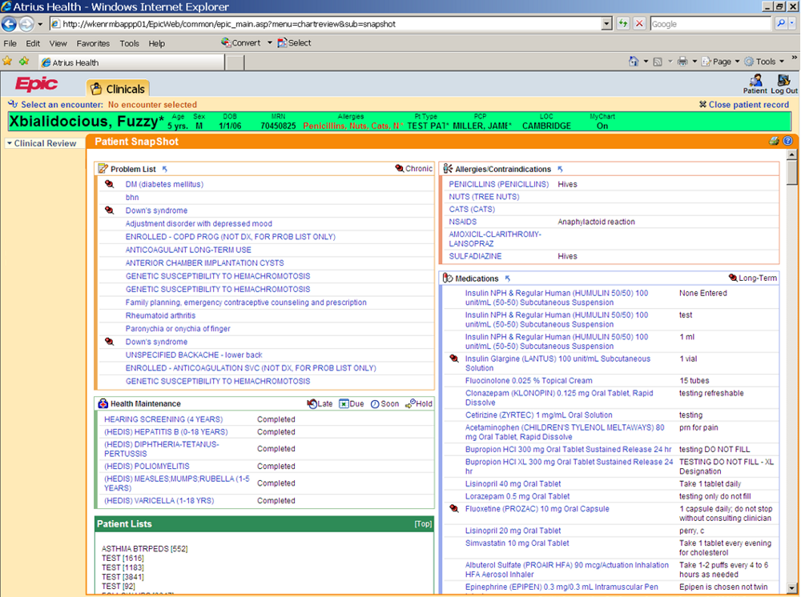
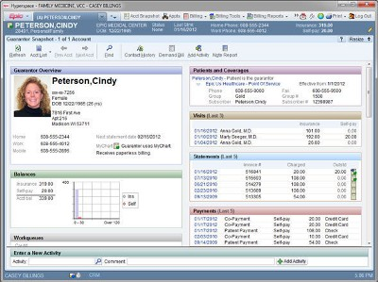
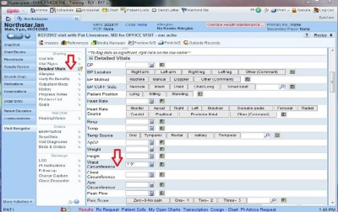
How Bad UX Killed Jenny, Jonathan Shariat

Slide 11
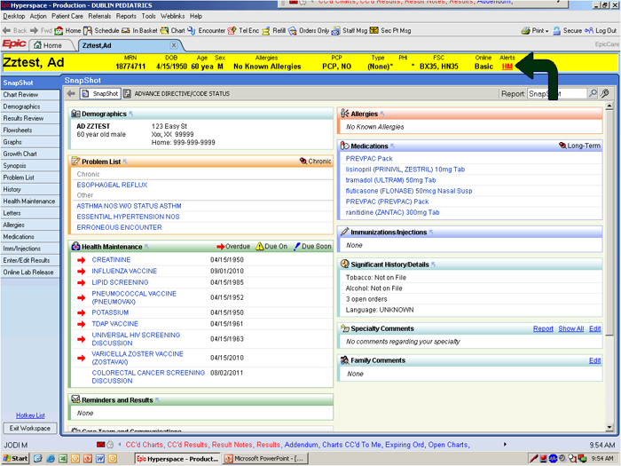

Slide 12
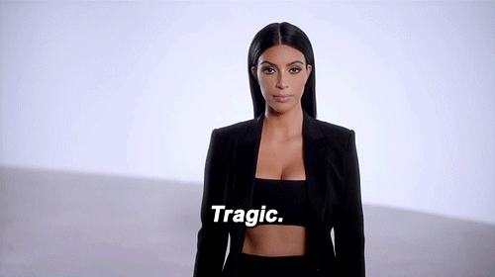
Tragic Design, Jonathan Shariat and Cynthia Savard Saucier
Notes:
Tragic Design examines real case studies that show how certain design choices adversely affected users.
Designs that anger, through impolite technology and dark patterns
How design can inadvertently cause emotional pain
Designs that exclude people through lack of accessibility, diversity, and justice

Slide 13
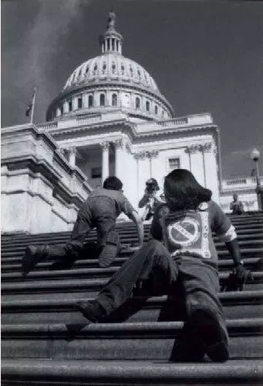
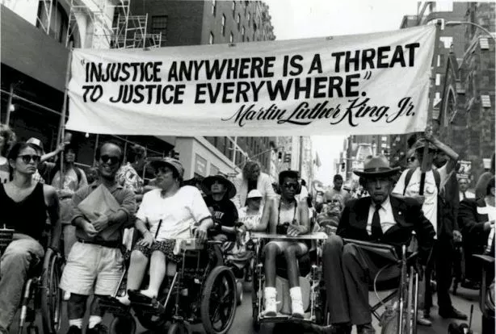
“Curb Cuts”, 99% Invisible
Notes:
Accessibility movement actually started here in Berkeley, California

Slide 14

Ultimately, design is about problem solving.

Slide 15

Design

Slide 16
User Interface Design
Physical Product Design
Graphic Design
Product Design
Visual Design
User Experience Design
User Research
User Testing
Service Design
Notes:
BUZZWORDS LMAO

Slide 17
User Interface and User Experience Design

Slide 18
User Interface (UI)
the space where interactions between humans and machines occur

Slide 19
User Experience (UX)
a person’s emotions and attitudes about using a product, system, or service

Slide 20
Basically: form, meet function.
Notes:
They must work in tandem!

Slide 21
Fidelity Explanation

Slide 22
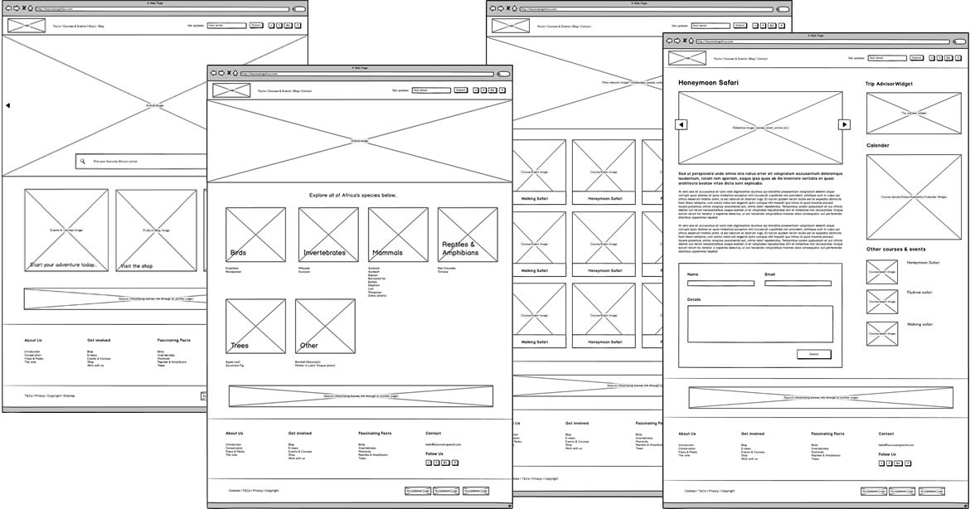
Low/Mid Fidelity

Slide 23
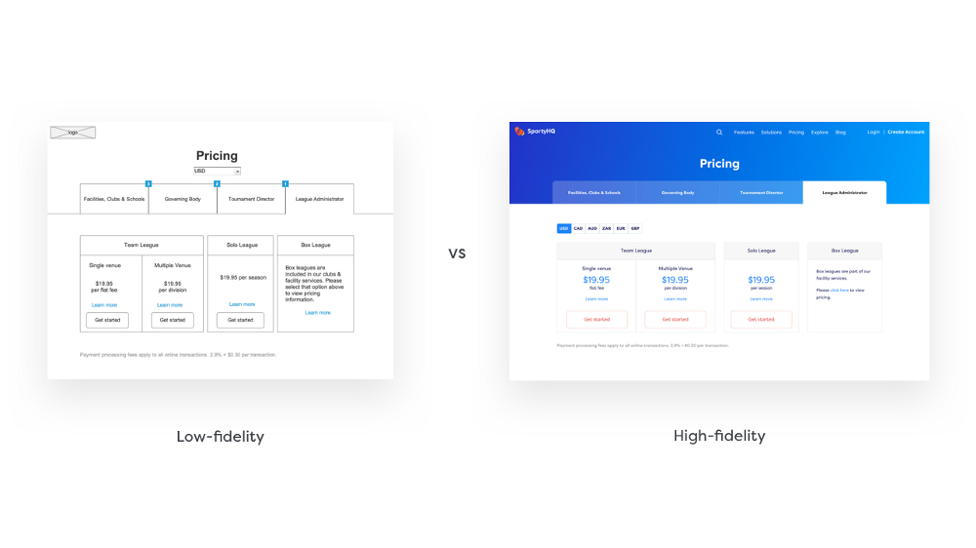
High Fidelity

Slide 24
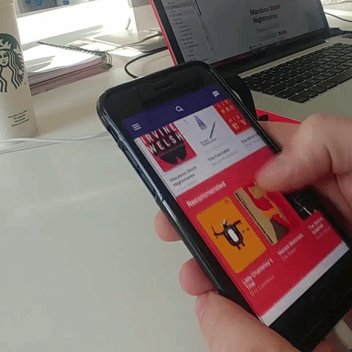
Interactive Prototypes

Slide 25

Wireframing and Prototyping Demo

Slide 26


Slide 27
Putting it all together
Wireframe → Mockup → HTML

Slide 28
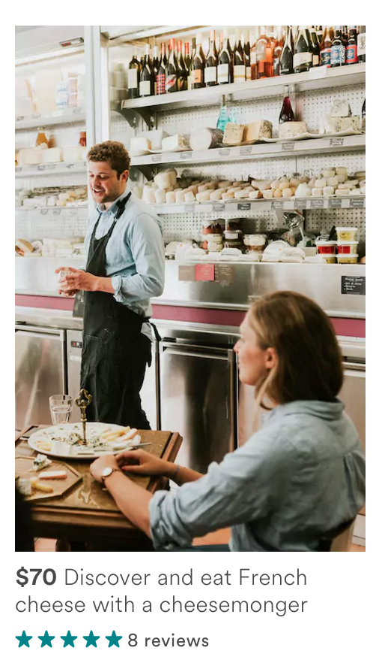
Wireframe
Website
HTML
<div> <!-- Container -->
<div><img></div>
<div> <!--Price, title --> </div>
<div> <!-- Rating -- > </div>
</div>

Slide 29
Wireframe
Website
HTML
<div> <!-- Container -->
<div><img></div>
<div> <!--Price, title --> </div>
<div> <!-- Rating -- > </div>
</div>

Slide 30
Wireframe
Website
HTML
<div> <!-- Container -->
<div><img></div>
<div> <!--Price, title --> </div>
<div> <!-- Rating -- > </div>
</div>

Slide 31
Wireframe
Website
HTML
<div> <!-- Container -->
<div><img></div>
<div> <!--Price, title --> </div>
<div> <!-- Rating -- > </div>
</div>

Slide 32
Wireframe
Website
HTML
<div> <!-- Container -->
<div><img></div>
<div> <!--Price, title --> </div>
<div> <!-- Rating -- > </div>
</div>

Slide 33

Encouragement Interlude
We all need a little sometimes!
Notes:
I just kind of want to end today’s lecture with a little encouragement because I know the first full week is very overwhelming! Another thing a lot of people tell me who want to pursue design specifically is that, “I’m really bad at this! There are a lot of designers that are already better than I am…” And cue the imposter syndrome, etc etc.

Slide 34
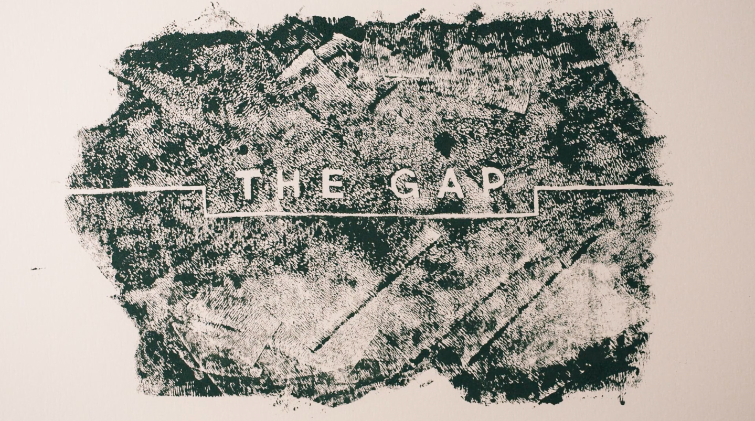
The Gap, By Ira Glass
Notes:
The Gap is part 2 of a 3 part series in storytelling, actually, but I feel very genuinely that design in itself is storytelling.

Slide 35

If you’re interested in design...
Notes:
If you want to pursue design as a career-- please please feel free to reach out to us. I know this was a much higher level look at design than simply web design, but these are really the fundamentals of design!

Slide 36
Notes:
If you want to pursue design as a career-- please please feel free to reach out to me

